Slide 1
Аритметични оператори
Сравнение
Стрингове и събстрингове
Събиране +
Изваждане -
Умножение *
Деление /
Степенуване **
Остатък %
Целочислено делене //
Скоби ( )
По-малко <
По-голямо >
По-малко или равно <=
По-голямо или равно >=
Равно ==
Различно !=
seq = “GGGGAAGGGG”
length = len(seq)
loc = seq.find(“AA”)
substr = seq[4:6]
concat = seq[:3] + seq[-3:]
Променливи
а = 2
b = 3
b += 1
c = a + b
print (“The sum is “)
print (c)

Slide 2
Изрязване на рестрикционен мотиф от ДНК последователност
EcoRI
sequence = "GGGGAATTCTT"
restriction_site = "GAATTC"

Slide 3
Изрязване на рестрикционен мотиф от ДНК последователност
sequence = "GGGGAATTCTT"
restriction_site = "GAATTC"
# Find the start index of the restriction site
# Find the end index of the restriction site
# Get the first part, second part and concatenate them

Slide 4
Изрязване на рестрикционен мотиф от ДНК последователност
sequence = "GGGGAATTCTT"
restriction_site = "GAATTC"
# Find the start index of the restriction site
start = sequence.find(restriction_site)
# Find the end index of the restriction site
# Get the first part, second part and concatenate them

Slide 5
Изрязване на рестрикционен мотиф от ДНК последователност
sequence = "GGGGAATTCTT"
restriction_site = "GAATTC"
# Find the start index of the restriction site
start = sequence.find(restriction_site)
# Find the end index of the restriction site
end = start + len(restriction_site)
# Get the first part, second part and concatenate them

Slide 6
Изрязване на рестрикционен мотиф от ДНК последователност
sequence = "GGGGAATTCTT"
restriction_site = "GAATTC"
# Find the start index of the restriction site
start = sequence.find(restriction_site)
# Find the end index of the restriction site
end = start + len(restriction_site)
# Get the first part, second part and concatenate them
new_sequence = sequence[0:start] + sequence[end:]
print (new_sequence)

Slide 7


Slide 8
Условни оператори
a = 17234
if a % 3 == 0:
print (“The number is divisible by 3.”)
result = a/3
print (“And the result is “ + str(result))
else:
print (“The number is not divisible by 3.”)

Slide 9
Условни оператори
a = 17234
if a % 3 == 0:
print (“The number is divisible by 3”)
elif a % 4 == 0:
print (“The number is divisible by 4 but not 3”)
elif a % 7 == 0:
print (“The number is divisible by 7 but not 3 or 4”)
else:
print (“The number is divisible by neither 3, 4 or 7”)

Slide 10
if a % 3 == 0 and a % 4 == 0:
print (“The number is divisible by both 3 and 4.”)
if a % 3 == 0 or a % 4 == 0:
print (“The number is divisible by either 3 or 4, or maybe both.”)

Slide 11
Вложени if оператори
x = 41 if x > 10: print("Above ten,") if x > 20: print("and also above 20") else: print("but not above 20.")

Slide 12
Булева алгебра
False and False → False
False and True → False
True and False → False
True and True → True
False or False → False
False or True → True
True or False → True
True or True → True

Slide 13
Булева алгебра
a and b
a and b and c
(a and b) or (c and d)
a and (not b)
Закон на де Морган:
not (a and b) → (not a) or (not b)

Slide 14
Изрязване на рестрикционен мотиф от ДНК последователност
sequence = "GGGGAATTCTT"
restriction_site = "GAATTC"
# Find the start index of the restriction site if it’s inside
start = sequence.find(restriction_site)
if start == -1: # check if the site is inside the string
new_sequence = sequence
print (“motif not found”)
else:
# Find the end index of the restriction site
end = start + len(restriction_site)
# Get the first part, second part and concatenate them
new_sequence = sequence[0:start] + sequence[end:]
print (“found”)
print (new_sequence)

Slide 15
Точки Оценка
0 – 30 2
31-50 3
51-65 4
65-80 5
81-100 6

Slide 16
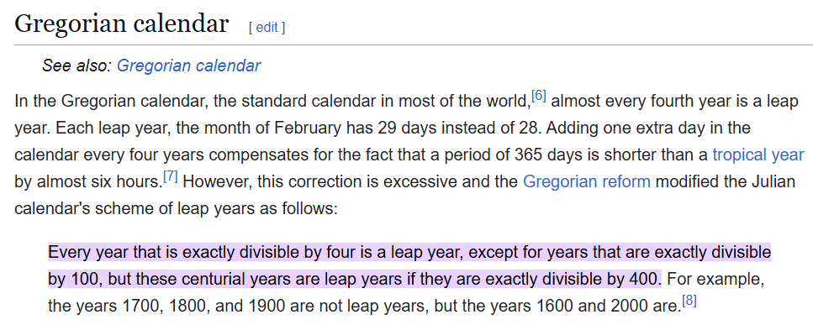

Slide 17
